Slide 1


BE Project Presentation
On
“SECURE E WALLET ARCHITECTURE USING BLOCKCHAIN TECHNOLOGY”
By
Jay Pardeshi
Jay Sharma
Sunil Bhadu
Atharva Tribhuwane
Dhole Patil College of Engineering Department of Information Technology
Guide
Prof. Yugashree Bhadane

Slide 2
Agenda
Abstract.
Introduction.
Problem Statement
Motivation
Literature Survey.
Proposed Work.
Project Objective
H/W, S/W Requirement
Modules
Design
Mathematical Module
Conclusion
Future Work
Reference

Slide 3
Abstract
Banking and technology are very closely associated and innovations have changed banking drastically over the period of time.
The digital innovations in the banking sector started with the introduction of money that replaced the barter system and then the gradual replacement of wax seal with digital signatures.
One such disruptive innovation which is changing the banking sector globally is Blockchain Technology (BCT).

Slide 4
Introduction
Blockchain is shared distributed ledger which stores business transaction to a permanent unbreakable chain which can be viewed by the parties in a transaction.
Blockchain technology has the potential to disrupt the ﬁnancial business applications as it provides permanent and tamper proof recording of transactions in a distributed network.
It can be widely applied in digital currency, trade finance, KYC and cross border remittances, etc. Although the potential of blockchain is enormous, it has various limitations of security, privacy and scalability which need to be addressed.

Slide 5

Problem Statement
To develop an android based wallet for secure mobile money using block chain technology using JSP & servlet technology.

Slide 6
Motivation
There are numerous such instances, where investors have lost their hard-earned money with banks owing to financial mismanagement at banks and consequently, the Reserve Bank of India (RBI) taking Prompt Corrective Action (PCA) against them.
Currently, UCO Bank, United Bank of India, Central Bank of India, Indian Overseas Bank, Punjab & Maharashtra Co-operative (PMC) Bank, to name a few are under the PCA of the RBI.

Slide 7
Literature Survey
Sr. No. | Paper Name | Author ,Year of publishing, Journals | Work
1. | Acceptance Towards Digital Payments and Improvements in Cashless Payment Ecosystem | Rahul Gupta,Cheshtha Kapoor,Jayesh Yadav, 2020, nternational Conference for Emerging Technology (INCET | this work represents SHARED WALLETS USING BLOCKCHAIN TECHNOLOGY
2. | Security Management and Visualization in a Blockchain-based Collaborative Defense | Christian Killer ; Bruno Rodrigues ; Burkhard Stiller 2019 IEEE International Conference on Blockchain and Cryptocurrency (ICBC) | this work presents the design of a security management dashboard for BloSS, designed for interactive use by cyber security analysts. This work is about DDos attacks in defense system.
3. | On the Effectiveness of Multi-Token Economies | Sean Kang; Kideok Cho; Kyle Park , 2019 IEEE International Conference on Blockchain and Cryptocurrency (ICBC) | This paper addresses the token classification, the reason for adopting multi-token economies and the effectiveness of them. We analyze the Steemit as a representative example of multi-token economies. We describe how the multi-token economy has been working and show the distinctive features of multi-token economies. We also propose the evaluation criteria for multi-token economies

Slide 8
Existing System
Due to a considerable segment of the Indian economy remaining informal, there’s still a huge part of the population that doesn't rely on traditional financial institutions for financial services.
Based on the cashless technologies employed today, most people would need a bank account in order to live in a cashless economy an uphill battle. In essence, for you to run a cashless economy, you’ll need an alternative to traditional financial services.

Slide 9
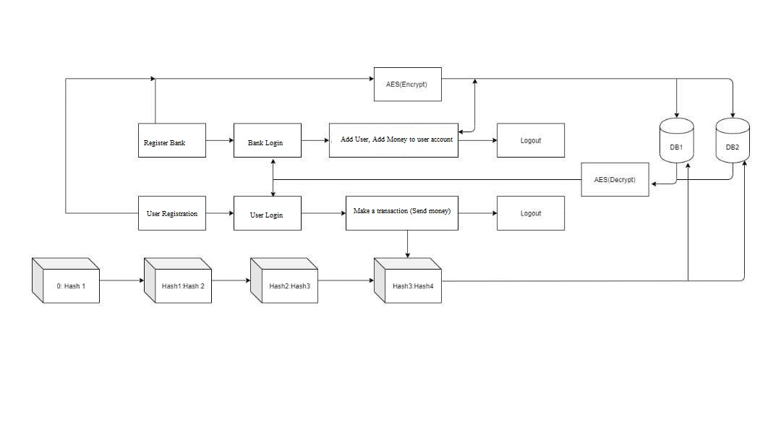
Proposed System

Slide 10
System Requirement
Software Requirement :
JDK 1.8
MYSQL
NETBEANS
APACHE TOMQAT SERVER
Hardware Requirement :
RAM : 4Gb
HDD : 250Gb

Slide 11
Modules: Block Chain
SHA 256 (Secure Hash Algorithm 256) is a cryptographic hash function with digest length of 256 bits
A message is processed by blocks of 512 = 16 × 32 bits, each block requiring 64 rounds
A cryptographic hash (sometimes called ‘digest’) is a kind of ‘signature’ for a text or a data file. SHA-256 generates an almost-unique 256-bit (32-byte) signature for a text

Slide 12
Modules: Block Chain
A hash is not ‘encryption’ – it cannot be decrypted back to the original text (it is a ‘one-way’ cryptographic function, and is a fixed size for any size of source text).
This makes it suitable when it is appropriate to compare ‘hashed’ versions of texts, as opposed to decrypting the text to obtain the original version.

Slide 13
Modules: Database Encryption
STEPS:
Derive the set of round keys from the cipher key.
Initialize the state array with the block data (plaintext).
Add the initial round key to the starting state array.
Perform nine rounds of state manipulation.
Perform the tenth and final round of state manipulation
Copy the final state array out as the encrypted data (ciphertext).

Slide 14
UML DIAGRAMS

Slide 15
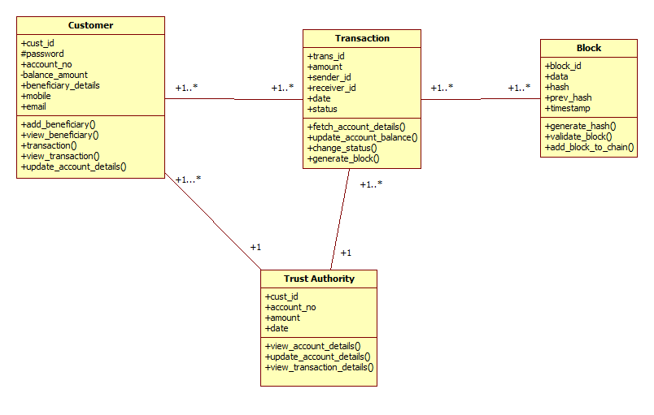

CLASS DIAGRAMS

Slide 16
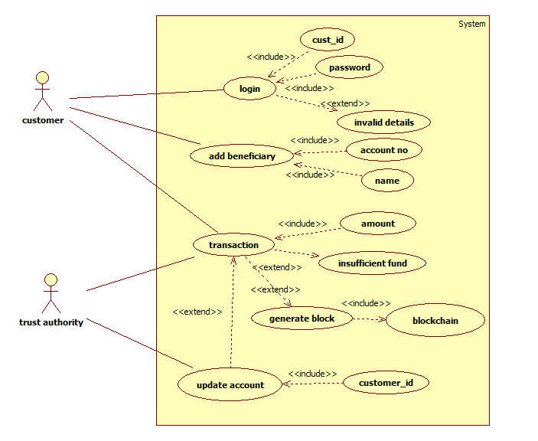
USE CASE DIAGRAMS

Slide 17
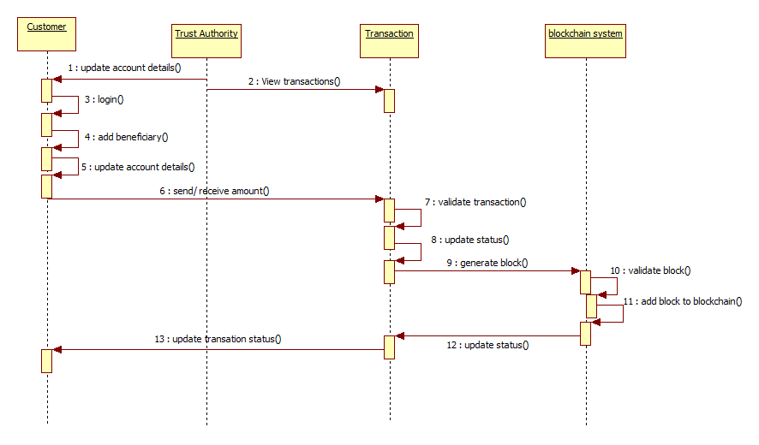
SEQUENCE DIAGRAMS

Slide 18
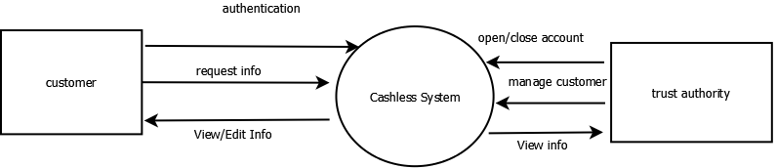
Data Flow Diagram(DFD)-1

Slide 19
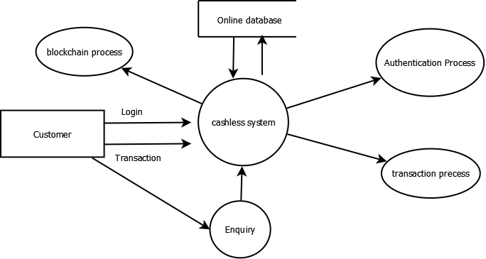
Data Flow Diagram(DFD)-2

Slide 20
Mathematical Module

Slide 21
Conclusion
Thus we have built Web-application for Admin and Bank use and an android app for customer use which is secure, transparent, and user friendly.
We implemented blockchain features such as:
Decentralization using WLAN
Hash Algorithm
Encrypted Database

Slide 22
Future Work
1) Our Project Currently working in Private Network and we are looking toward Public accessibility
2) Our project Running on laptop and we are looking to take AWS/GCP server for better performance
3) We are currently limited in nodes so we are looking to increasing our node (Database)
4)Our web/Android Application is not available on MacOS/Iphone

Slide 23
References
[1] D. Mills et al., “Distributed ledger technology in payments, clearing, and settlement,” Finance and Economics Discussion Series 2016- 095. Washington: Board of Governors of the Federal Reserve System, https://doi.org/10.17016/FEDS.2016.095.
[2] The Financial Industry Regulatory Authority Report, http://www.finra.org/sites/default/files/FINRA Blockchain_Report.pdf, January 2017
[3]http://economictimes.indiatimes.com/articleshow/61715860.cms?utm source=contentofinterest&utmmedium=text&utm_campaign=cppst,November 2017.
[4] S. Nakamoto, “Bitcoin: A peer-to-peer electronic cash system, 2009,” 2012. [Online]. Available: http://www.bitcoin.org/bitcoin.pdf
[5] Z. Zheng, S. Xie, H. Dai, X. Chen and H. Wang., "An overview of blockchain technology: Architecture, consensus, and future trends.“ In 2017 IEEE International Congress on Big Data (BigData Congress), 2017 Jun 25 (pp. 557-564). Honolulu, USA, DOI: 10.1109/BigDataCongress.2017.85

Slide 24
References
[6] https://en.bitcoin.it/wiki/Transactions (visited on 05/28/2013).
[7] M. Ober, S. Katzenbeisser, and K. Hamacher., "Structure and Anonymity of the Bitcoin Transaction Graph". Future internet, 5(2):237–250, May 2013
.
[8] http://blockchain.info/de/wallet/send-shared (visited on 05/31/2013).
[9] M. Möser , “Anonymity of Bitcoin Transactions” , An Analysis of Mixing Services . Münster Bitcoin Conference (MBC), 17–18 July 13, Münster, Germany.
[10] V. Dhar and R. Roger, "FinTech Platforms and Strategy " MIT Sloan Research Paper No. 5183-16. Available at SSRN https://ssrn.com/abstract=2892098 or http://dx.doi.org/10.213 9/ssrn.2892098

Slide 25
Thank You

